Slide 1

Project Title : MRI-to-Synthetic CT Brain Scan Translation
Name: Vishal Kumar
Student Code: iitmcs_2406329
Method: Deep Learning for Medical Imaging

Slide 2
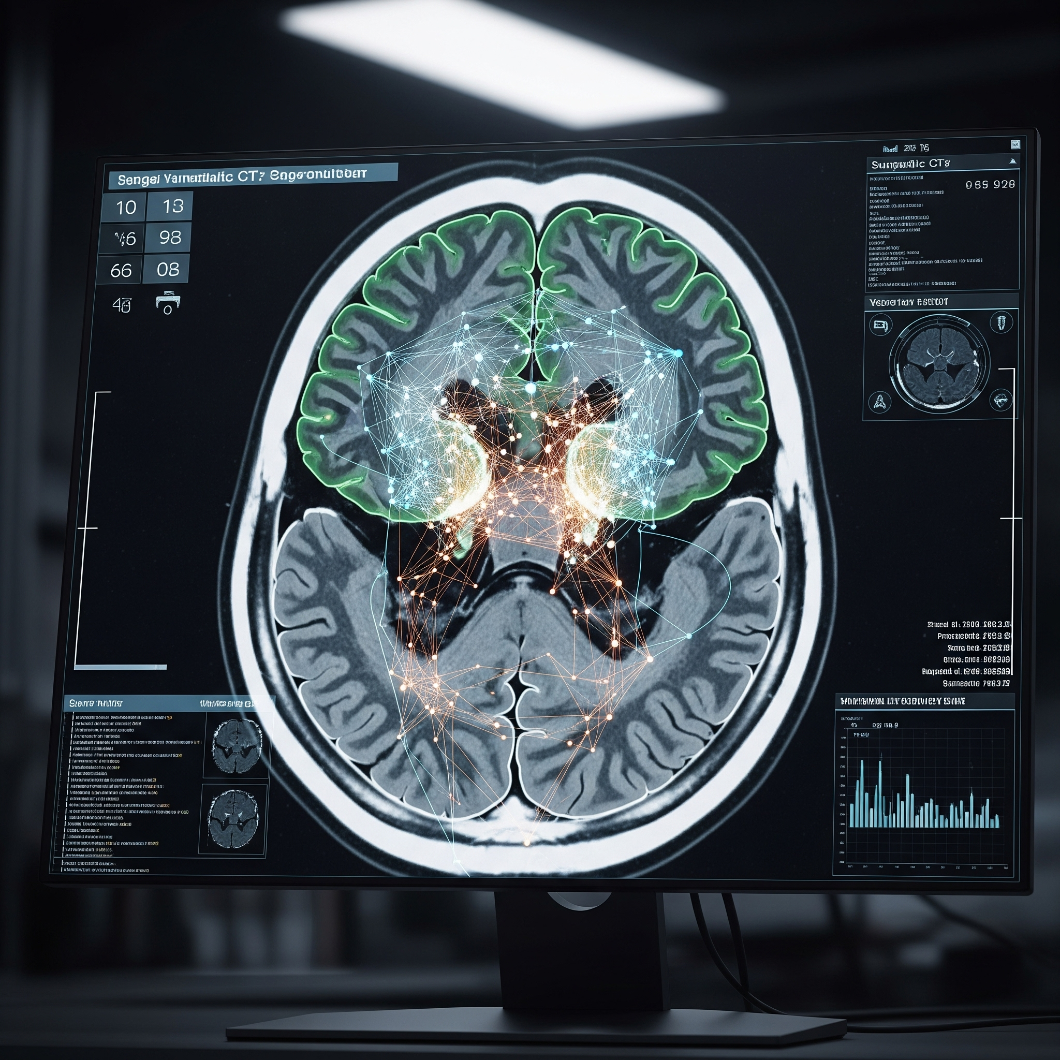
Project Overview
The Clinical Problem
Radiotherapy planning for brain tumors currently requires both MRI (for soft tissue detail) and CT (for dose calculation). This dual-scan process is costly, time-consuming, and exposes patients to unnecessary radiation. It also introduces the risk of image registration errors.
Our Project's Goal
To develop a deep learning model that generates high-fidelity synthetic CT (sCT) scans directly from MRI images. The ultimate aim is to enable a faster, safer, and more efficient "MRI-only" clinical workflow.

Slide 3

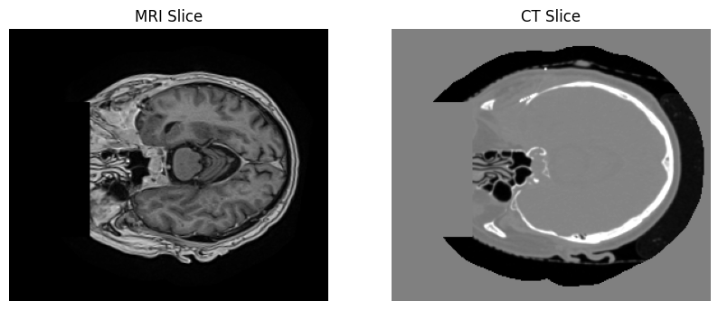
Project Introduction
Addresses logistical burdens in clinical workflows
Synthesizes CT from MRI using deep learning
Utilizes Pix2Pix for image-to-image translation
Optimizes G:D ratio and replacing reconstruction loss with charbonnier loss

Slide 4
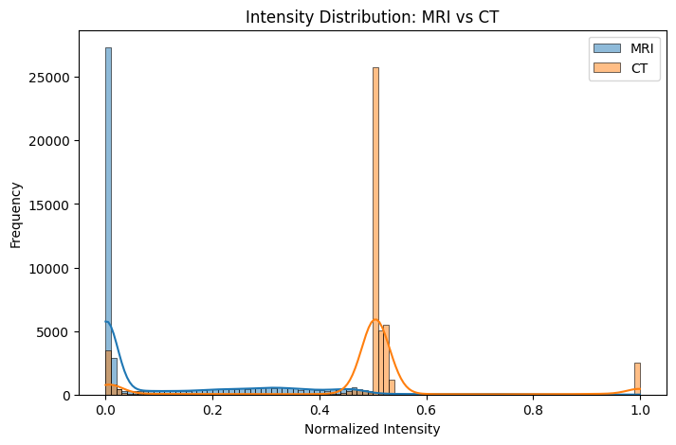
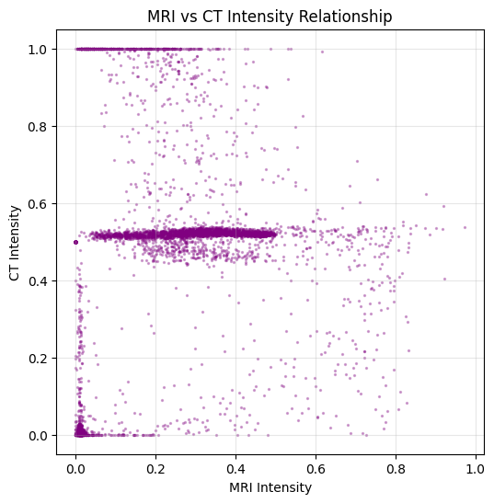
MRI vs CT Intensity Distribution & Relationship

Slide 5
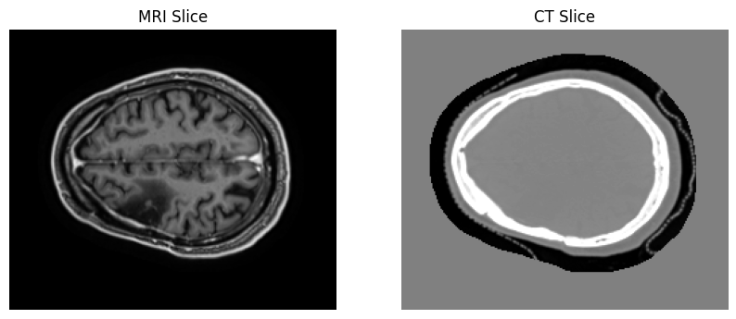
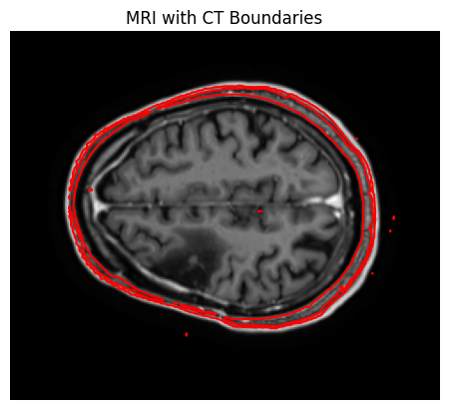
MRI with CT Boundaries Visualization

Slide 6
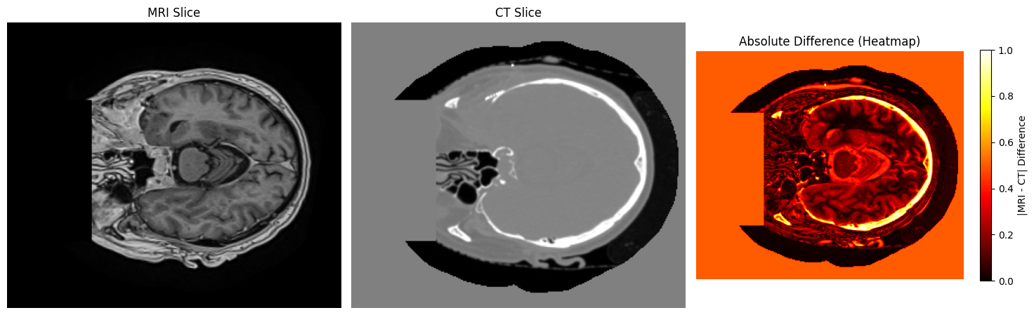
Modality Contrasts
(Absolute Difference=MRI_slice-CT_slice)

Slide 7
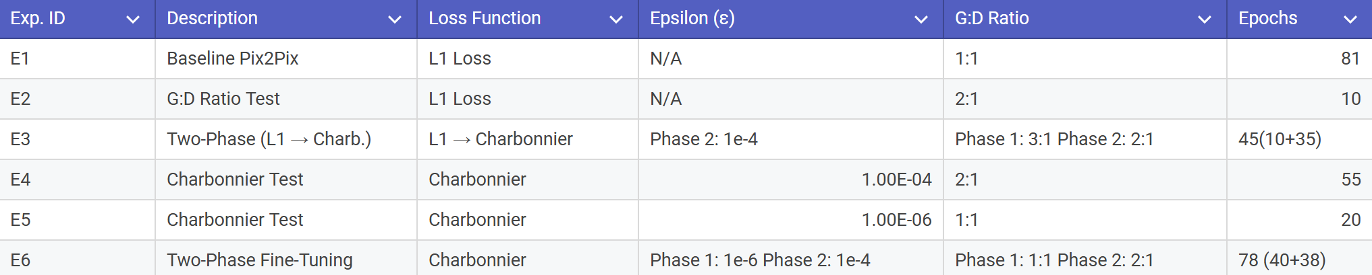
Methods and Experiments
A series of experiments were conducted using a paired MRI-CT dataset to identify an optimal training configuration for the Pix2Pix framework. Performance was evaluated using Peak Signal-to-Noise Ratio (PSNR), Structural Similarity Index (SSIM), and Mean Absolute Error (MAE). The experimental setups are detailed below, progressing from a baseline to exploratory tests and culminating in a two-phase fine-tuning strategy.

Slide 8
Experiment 1 : Baseline Pix2Pix
Goal: To establish the performance benchmark for a standard model.
Method: We trained the original Pix2Pix architecture using L1 loss with a 1:1 G:D ratio for a full 81 epochs.
Key Finding: This model set the "gold standard" for our project. It achieved the best overall metrics from a single training run, with a PSNR of 34.75, an SSIM of 0.954, and a low MAE of 13.22. All other experiments were measured against this strong baseline.
Experiment 2: G:D Ratio Test (2:1)
Goal: To explore if an accelerated G:D ratio could improve training speed.
Method: We trained the standard model for a short 10-epoch run but increased the generator's training frequency with a 2:1 G:D ratio.
Key Finding: This was an exploratory test that yielded a PSNR of 32.35, an SSIM of 0.930, and an MAE of 17.56. It provided a useful data point when compared to the more aggressive 3:1 ratio test, helping to inform our later, more complex experiments.

Slide 9
Experiment 3: Two-Phase (L1 → Charbonnier)
Goal: To test if an aggressive L1 "kickstart" could effectively prime the model for a more robust Charbonnier training phase.
Method: This was a two-phase strategy. Phase 1 used L1 loss with a 3:1 ratio for 10 epochs. Phase 2 switched to Charbonnier loss with a 2:1 ratio for 35 epochs.
Key Finding: This strategy produced strong intermediate results, with a PSNR of 33.35, SSIM of 0.940, and MAE of 16.05. However, it was ultimately outperformed by our E6 strategy, suggesting that starting with Charbonnier loss from the beginning yields a better foundation.
Experiment 4: Charbonnier Test (ε=1e-4)
Goal: To evaluate the performance of the Charbonnier loss with a specific epsilon and an accelerated training ratio.
Method: We trained the model for 20 epochs using Charbonnier loss (ε=1e-4) combined with a 2:1 G:D ratio.
Key Finding: This configuration proved to be highly efficient. It produced excellent results for such a short run, with a PSNR of 33.81, an SSIM of 0.946, and an MAE of 14.68, confirming the benefits of the Charbonnier loss.

Slide 10

Experiment 5 : Charbonnier Test (ε=1e-6)
Goal: To evaluate the Charbonnier loss with a smaller epsilon and a standard training ratio.
Method: We trained for 40 epochs using Charbonnier loss with a very small epsilon (ε=1e-6) and a stable 1:1 G:D ratio.
Key Finding: This experiment was crucial as it established the ideal "Phase 1" for our winning model. It achieved a PSNR of 32.75, SSIM of 0.937, and MAE of 16.31, showing that starting with a stable 1:1 ratio and a sharp, L1-like Charbonnier loss created the perfect foundation for later fine-tuning.

Slide 11

Experiment 6 : Two-Phase Fine-Tuning (Winning Model)
Goal: To combine all previous insights into a definitive strategy to achieve state-of-the-art results with high efficiency.
Method: This was our winning two-phase approach. We started with the stable E5 setup for 40 epochs, then fine-tuned for 38 epochs with an accelerated 2:1 ratio and a smoother loss (ε=1e-4).
Key Finding: This model is the undisputed top performer. It surpassed the baseline in less epochs, achieving the best metrics overall: a PSNR of 35.74, an SSIM of 0.962, and the lowest MAE of 11.49. This proves that a sophisticated, multi-stage fine-tuning strategy is the superior methodology.

Slide 12
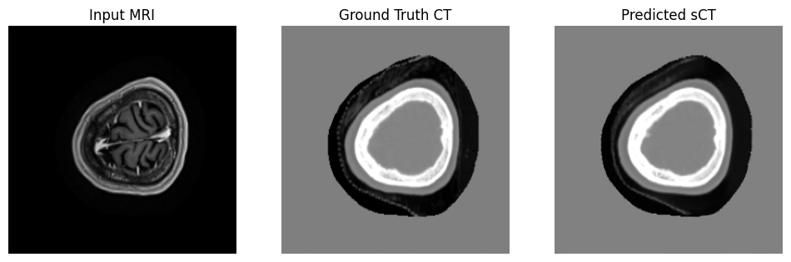
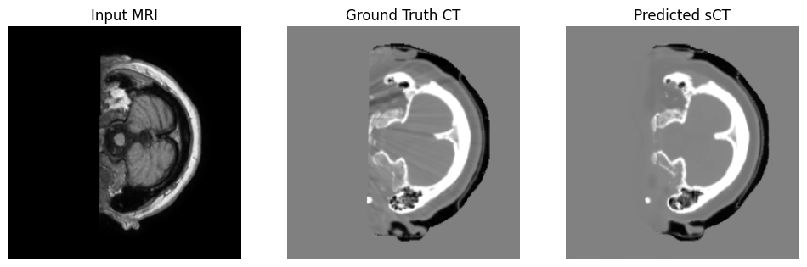
sCT generated by Winning Model (E6) :

Slide 13
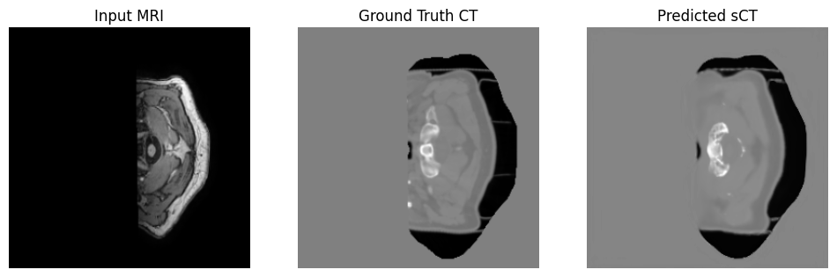
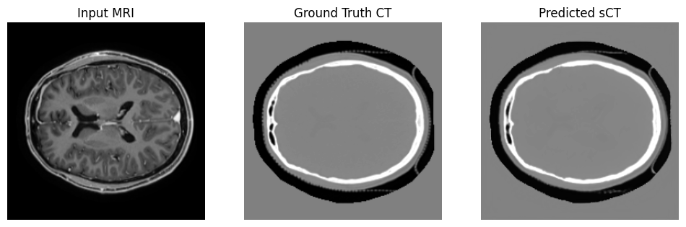

Slide 14
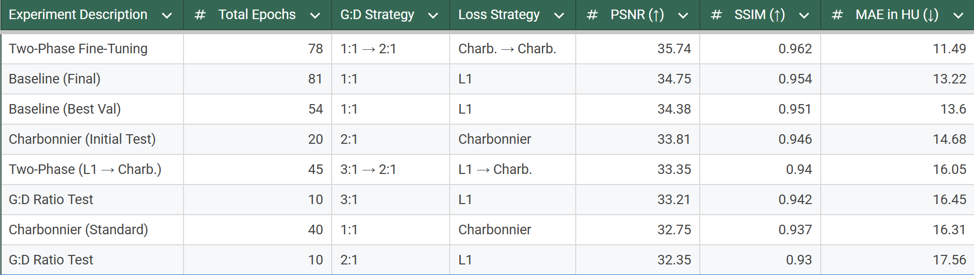
Quantitative Results Summary
The performance of each experimental configuration on the test set is summarized in the table below. The "Two-Phase Fine-Tuning" experiment emerged as the clear top performer, achieving the best overall results across all key metrics. This optimized model surpassed the strong performance of the fully-trained 81-epoch baseline model. Notably, the baseline model saved at 54 epochs based on validation loss also showed very strong results, confirming the effectiveness of the standard approach when properly validated.

Slide 15

Analysis and Interpretation
The Baseline (E1): A standard 81-epoch Pix2Pix model set a strong performance benchmark with a PSNR of 34.75, but required significant training time.
Early Insights: Initial tests showed that an accelerated 3:1 G:D ratio (E3) could speed up early convergence, achieving a respectable PSNR of 33.21 in just 10 epochs.
The Key Innovation: The Charbonnier loss proved to be the most critical factor for efficiency, achieving a high PSNR of 33.81 in only 20 epochs—demonstrating a more effective learning signal than the standard L1 loss.
The Winning Strategy (E6) : A Two-Phase Fine-Tuning approach became the undisputed top performer.

Slide 16

Conclusion & Key Takeaways
Key Findings : A standard Pix2Pix model with L1 loss provides a strong but time-consuming performance benchmark.The Charbonnier loss was the critical factor for efficiency, enabling the model to learn high-fidelity features much faster than the standard L1 loss.
The optimal configuration was a two-phase fine-tuning strategy, which achieved a new state-of-the-art result (PSNR of 35.74), surpassing the fully-trained baseline in fewer total epochs.
Key Takeaways : The project's main contribution is a novel, superior training methodology. A sophisticated, multi-stage training strategy that combines a stable initial phase with an aggressive fine-tuning period is the most effective path to achieving maximum quality and efficiency for this task.
Future work would be focused on Clinical Validation, Model Optimization and Generalization

